Slide 1
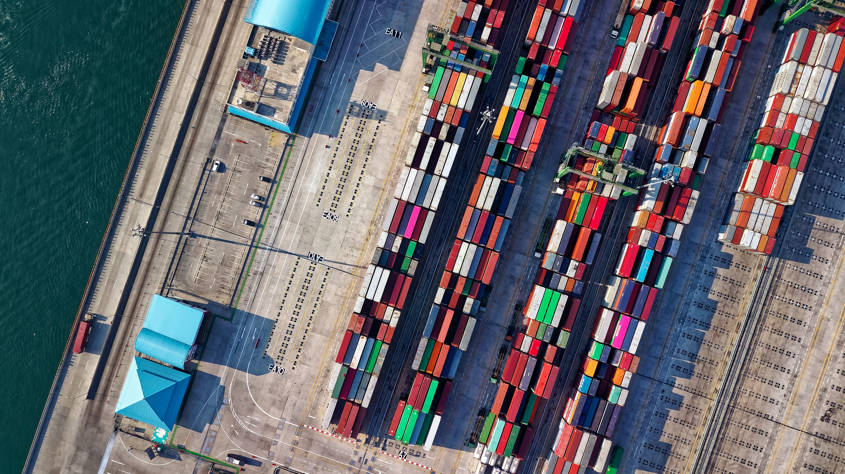
Kra Canal:
To build or not to build?

Slide 2
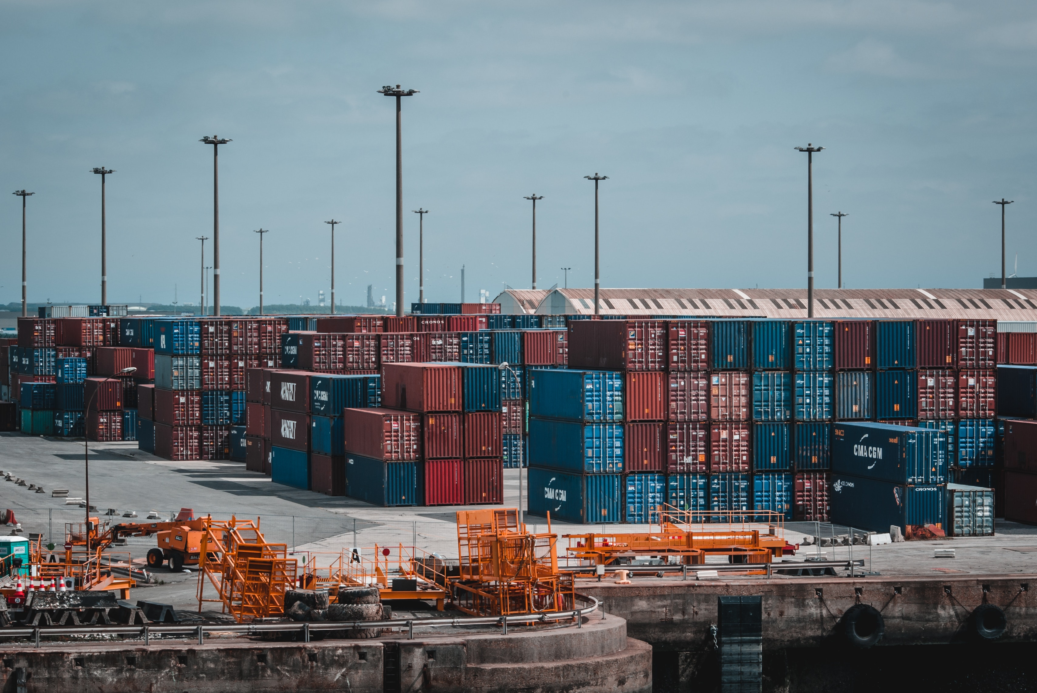
Content
1.
Background Analysis
2.
PESTLE Analysis
3.
Climate Data Analysis
4.
Financial Analysis
5.
Conclusion

Slide 3
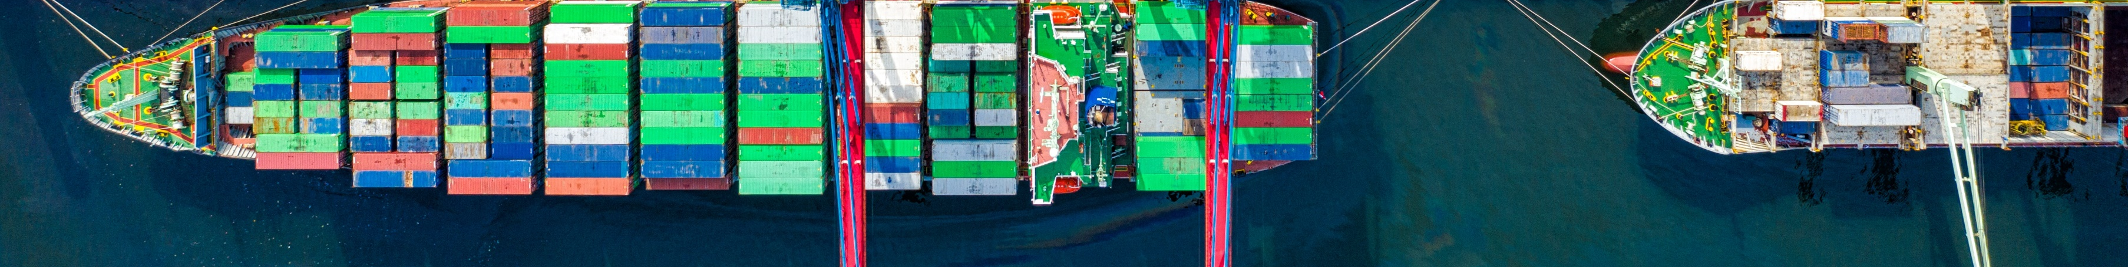


Kra Canal Explained
Notes:
3:18

Slide 4
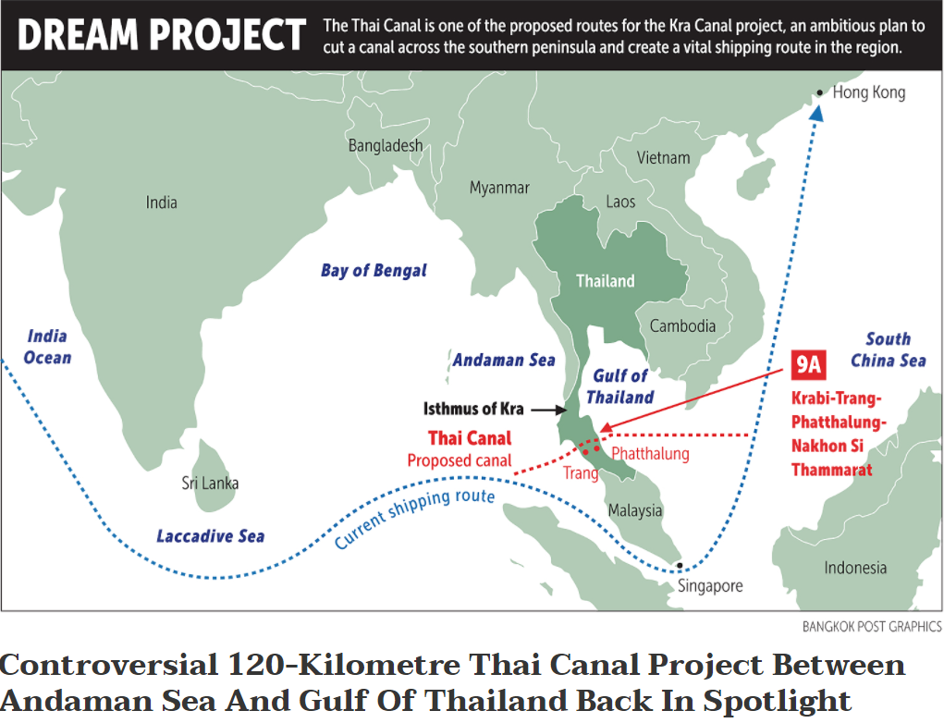
Background of
Kra Canal Project
Estimated cost: 28 Billion USD
Estimated construction period : 10 years
Main competitor: Strait of Malacca & Northern Sea Route

Slide 5
PESTLE Analysis
E
L
T
S
E
P

Slide 6
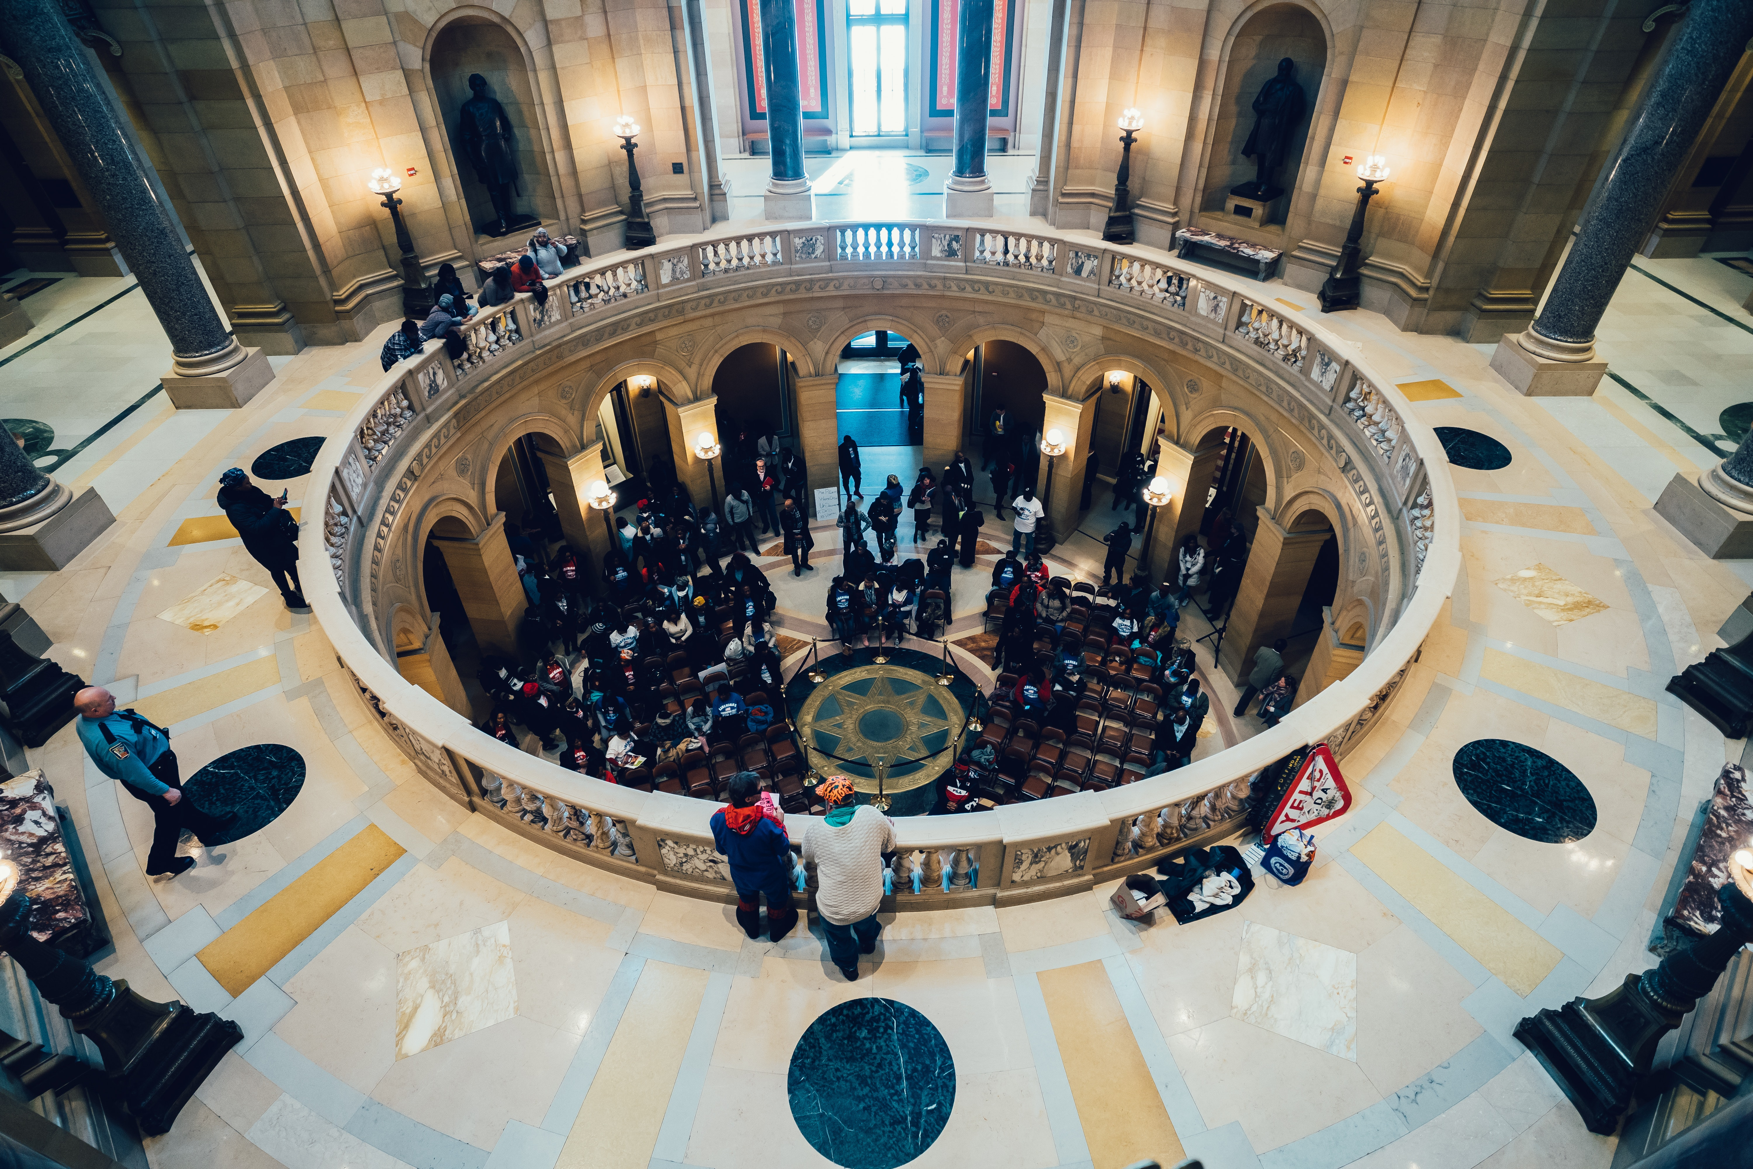

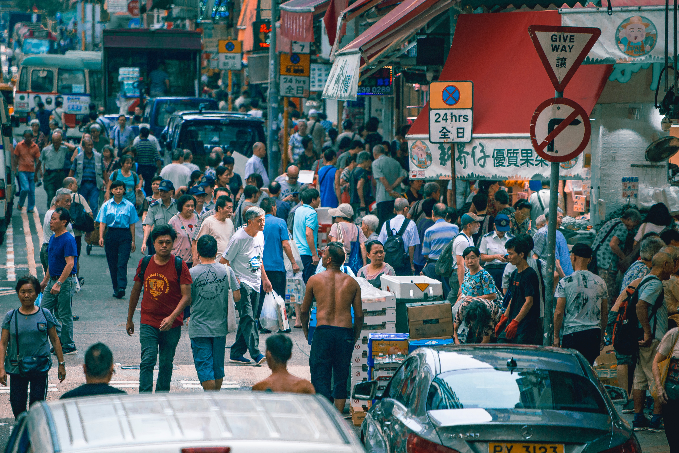



PESTLE - Review
Political
Economic
Social
Technological
Environmental
Legal
Notes:
South china sea trade and countries :
https://upcommons.upc.edu/bitstream/handle/2117/169660/140869_ElisendaVenturaJariod_TFG%20(1).pdf
Foreign investment % of GDP :
https://datatopics.worldbank.org/world-development-indicators/themes/economy.html
Trade balance :
https://comtrade.un.org/pb/
Politics of thailand :
https://en.wikipedia.org/wiki/Politics_of_Thailand

Slide 7
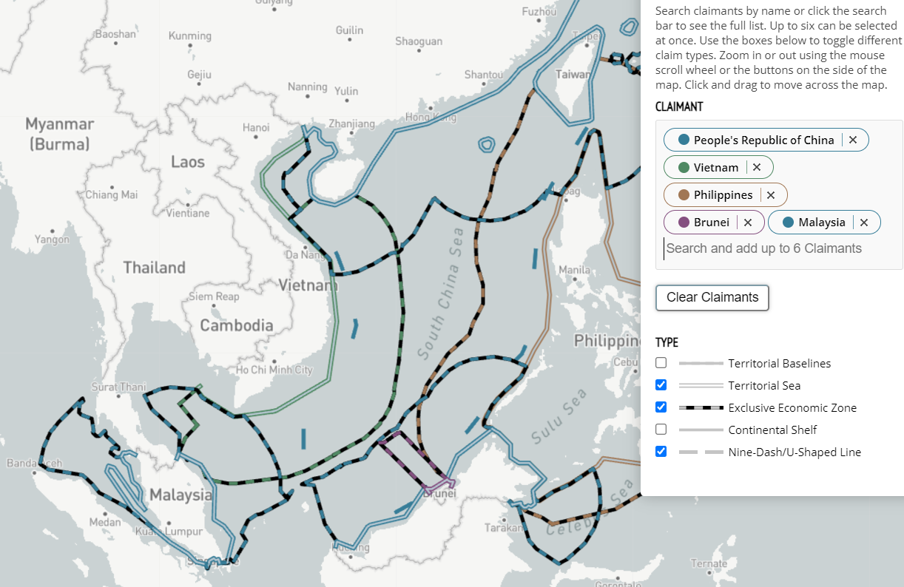
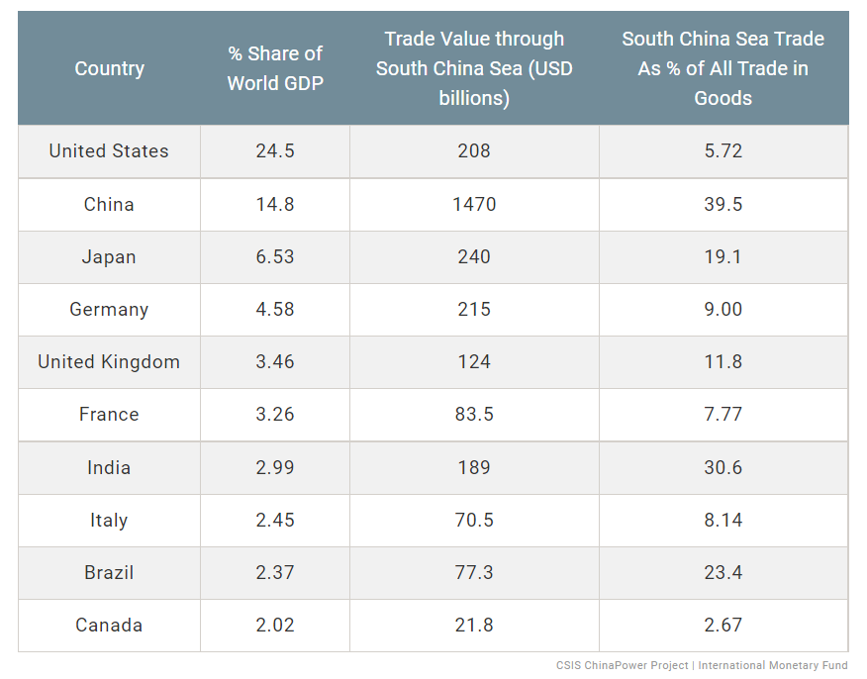
PESTLE Analysis: Political factors – part 1
Positive factors:
Shift the balance of power within ASEAN (an intergovernmental organization of 10 Southeast Asia countries), particularly in terms of trade and economic power
Promote Thailand as a hub for trade between China and ASEAN, and elevate its political status
Negative factors:
Externally, influences from multiple political power in the area are not to be ignored:
Eager to get rid of dependence on Malacca Strait, China will be in favor of Kra Canal.
Watchful of China's increasing influence, United States will oppose the project.
Seeking development and rise of international status, neighbor countries will want a say for their best interest
Notes:
South china sea trade and countries :
https://upcommons.upc.edu/bitstream/handle/2117/169660/140869_ElisendaVenturaJariod_TFG%20(1).pdf
https://amti.csis.org/maritime-claims-map/
Foreign investment % of GDP :
https://datatopics.worldbank.org/world-development-indicators/themes/economy.html
Trade balance :
https://comtrade.un.org/pb/
Politics of thailand :
https://en.wikipedia.org/wiki/Politics_of_Thailand

Slide 8
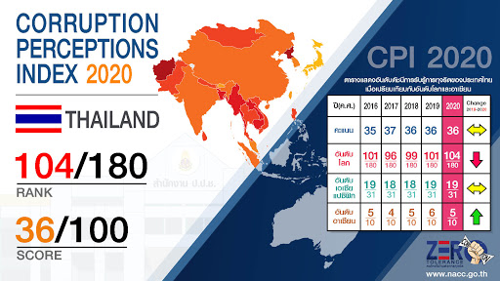
PESTLE Analysis: Political factors – part 2
Negative factors:
Domestically, unstable factors and threats of national separatism loom large:
Multiple forces including politicians, bureaucrats, influence peddlers, corporate leaders and army officers play against each other
Corruption has plagued Thailand for much of its modern history (Thailand is ranked 104th least corrupt by Corruption Perceptions Index).
The construction of Kra Canal forms a natural gap between north and south of Thailand, which will intensify separatist violence in the southern provinces, ultimately disrupt trade and stunt foreign investment activities in the area.
Notes:
South china sea trade and countries :
https://upcommons.upc.edu/bitstream/handle/2117/169660/140869_ElisendaVenturaJariod_TFG%20(1).pdf
Foreign investment % of GDP :
https://datatopics.worldbank.org/world-development-indicators/themes/economy.html
Trade balance :
https://comtrade.un.org/pb/
Politics of thailand :
https://en.wikipedia.org/wiki/Politics_of_Thailand

Slide 9
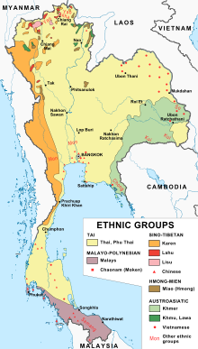
PESTLE Analysis: Social factors
Positive factors:
It is estimated, as many as 30,000 job vacancies will be created as a result of the construction and other services around the area, boosting the development of port economy
Overall infrastructure and real estate development will also benefit from Kra Canal project
Negative factors:
Due to multicultral and multiracial history, civil wars may be spured by ethnic, religious and/or tribal difference caused by the separation of Kra Canal
Example:
Since 1960s, more than 60 armed groups among Malay Muslim were raised.
A violence in 2004 caused more than 2400 deaths, and more than 4000 people were injured.
Notes:
South china sea trade and countries :
https://upcommons.upc.edu/bitstream/handle/2117/169660/140869_ElisendaVenturaJariod_TFG%20(1).pdf
Foreign investment % of GDP :
https://datatopics.worldbank.org/world-development-indicators/themes/economy.html
Trade balance :
https://comtrade.un.org/pb/
Politics of thailand :
https://en.wikipedia.org/wiki/Politics_of_Thailand

Slide 10
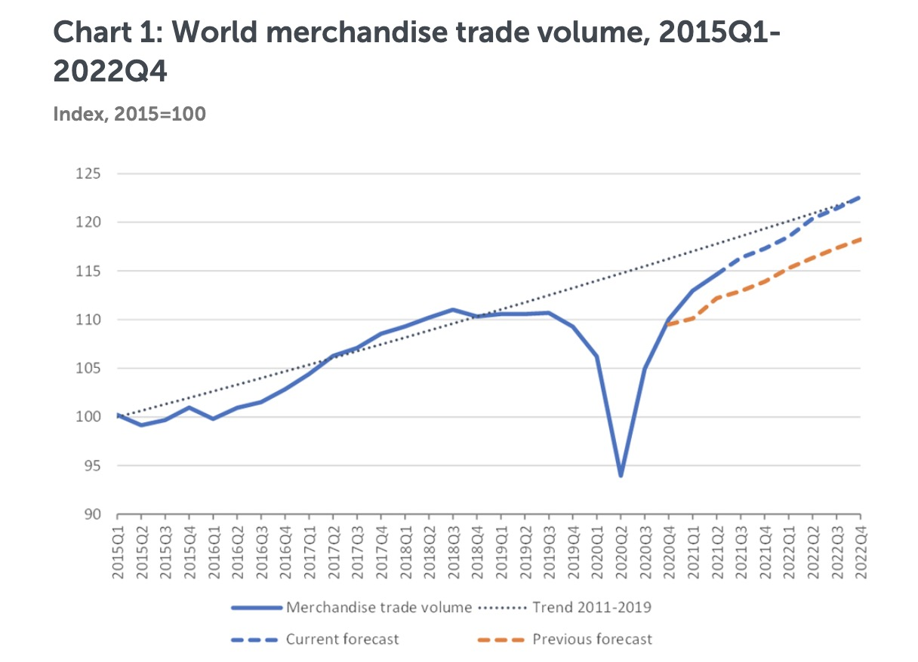
PESTLE Analysis: Economic factors
Positive factors:
Thailand could gain various economic benefits from Kra Canal:
Trade revenue: annual trade turnover estimated 280 billion USD
Revenue from related use of Kra Canal, such as, navigation and toll fees, income tax, export tariffs, and shipyard activities
Development of Songkhla port, growth of local industries and international trade and commerce.
Rise up as a regional center for commodities, currency trading, offshore financing, transshipment and others (ASEAN Affairs Magazine 2009)
Negative factors:
However, risks and uncertainties are also to be managed:
The project would bring huge amount of debt
Unstable and unpredictable world trade volume due to trade war between China and the US, as well as the pandemic
Low attractivness to foreign investment, the Economist Intelligence Unit rated Thailand a "flawed democracy" in 2019
Notes:
South china sea trade and countries :
https://upcommons.upc.edu/bitstream/handle/2117/169660/140869_ElisendaVenturaJariod_TFG%20(1).pdf
Foreign investment % of GDP :
https://datatopics.worldbank.org/world-development-indicators/themes/economy.html
Trade balance :
https://comtrade.un.org/pb/
Politics of thailand :
https://en.wikipedia.org/wiki/Politics_of_Thailand

Slide 11
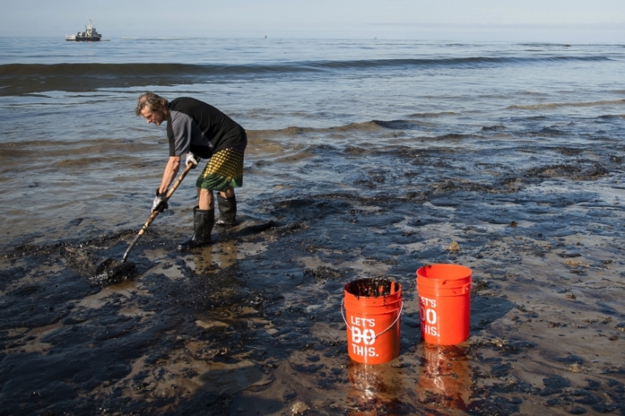
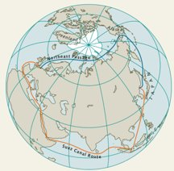
PESTLE External environment analysis
PESTLE Analysis: Environmental factors
Negative factors:
Like any other major construction project, the environmental issue remains a challenge:
Emissions and oil spills caused by ship activities
Destruction of marine habitat, biodiversity and ecosystem
Furthermore, climate changes bring in a new competitor -- Northern Sea Route:
Global warming makes a shipping route via Arctic Ocean possible, for detailed comparisons see on next slide's table
Notes:
South china sea trade and countries :
https://upcommons.upc.edu/bitstream/handle/2117/169660/140869_ElisendaVenturaJariod_TFG%20(1).pdf
Foreign investment % of GDP :
https://datatopics.worldbank.org/world-development-indicators/themes/economy.html
Trade balance :
https://comtrade.un.org/pb/
Politics of thailand :
https://en.wikipedia.org/wiki/Politics_of_Thailand

Slide 12
Environment: new competitor emerges
Global warming makes a long time route through Arctic sea possible
Element | Maritime Routes (via) |  | Statement
 | Suez Canal (SC) | Northern Sea Route (NSR)
Distance (nm) | 11585 | 7356 | [Far East vs. N.W. Europe] Yokohama - Hamburg Suez Route (11,585 N.M.) vs. NSR Route (7,356 N.M./-36%) The navigation distance from Northwest European port to Far East via NSR is an approximately 36% shorter compared Suez Canal route.
Fuel Consumption | High | Low | Norway to China: Shipping via the NSR save $550,000 in fuel costs compared to the journey via Suez Canal (Bulk Ship named MV Nordic Barents)
Journey Time | 32 days (15 knots) | 18 days (15 knots) | North-West Europe (London) to Far East (Yokohama) Shipping via the NSR save 14 days on the journey compared to via the Suez Canal by using same speed
Speed (Knots) | 15 knots 32 days | 9 knots 32 days | North-West Europe (London) to Far East (Yokohama) Shipping via the NSR using speed only 9 knots on the journey compared to via the Suez Canal by using 15 knots on speed
Piracy | Yes | No | There is also much reduced level of piracy through this northern route, compared to the risk of piracy for ships in the Indian Ocean that are using the Suez Canal A maritime route with transhipments (T/S) includes T/S charges at T/S ports. NSR Fee USD 674 per TEU
Fee | Low | High | Suez Canal Fee (SDR/GT) for the 1st 5,000GTx USD7.88+2nd 5,000GTx USD5.15+; 3rd 10,000GTxUSD4.12+;4th 20,000GTxUSD2.88+; 5th 30,000GTxUSD2.6+70,000GT(+)xUSD2.11
Transport Cost | High | Low | North-West Europe (Hamburg) to Far East (Yokohama) Transport cost via NSR (USD/TEU) <1,123 Via Suez Canal (USD/TEU) 1,299
Cost Saving | Low | High | Cost analysis may heavily depend on changes of bunker oil and ship-building prices as well as NSR, and Suez Canal fees. Thus, the shipping scenarios including navigation conditions would be a key factor to the cost analysis here. Severe competition will be expected among NSR and Suez Canals in the near future
Notes:
Religion map : https://maps-thailand-th.com/thailand-religion-map
Asia piracy : https://upcommons.upc.edu/bitstream/handle/2117/169660/140869_ElisendaVenturaJariod_TFG%20(1).pdf
Ship: https://jshippingandtrade.springeropen.com/track/pdf/10.1186/s41072-016-0016-0.pdf

Slide 13
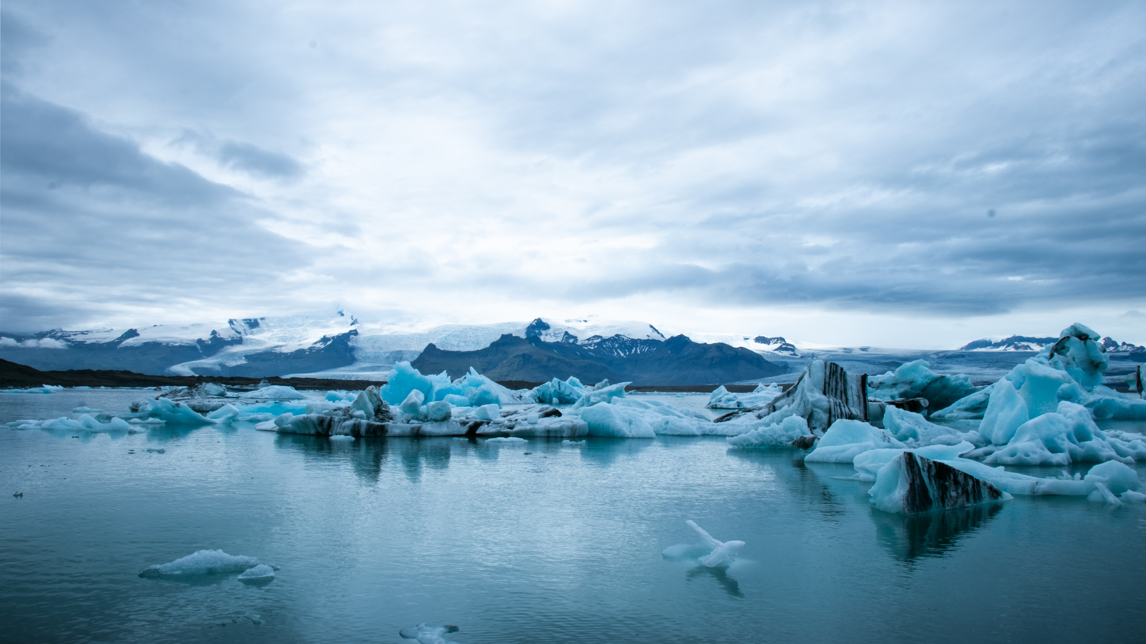
Climate Data Analysis -- Diversion to the Northern Sea Route

Slide 14
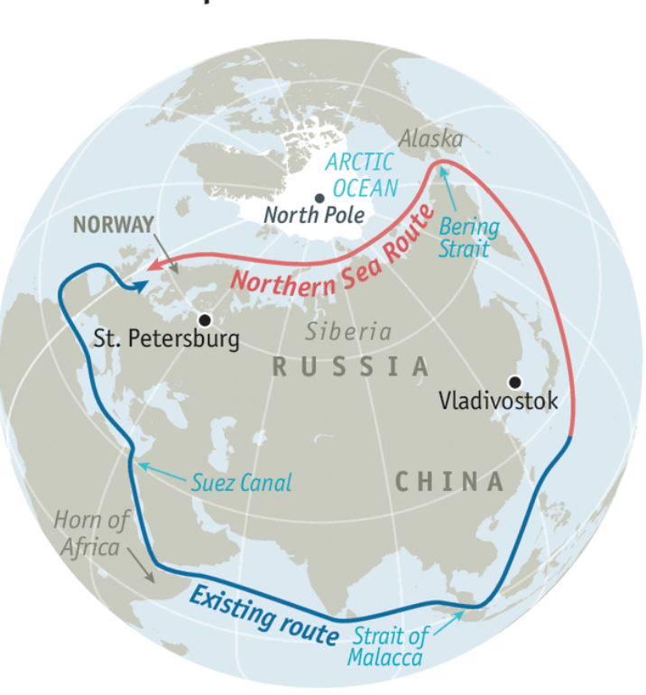
Climate Data Analysis
Background:
The Northern Sea Route is a shorter route to connect Northeast Asia and Western Europe compared to routes through the Suez Canal. With global warming and the melting of Arctic sea ice, the Northern Sea Route becomes more available than ever.
This could potentially have a negative impact on the profitability of Kra Canal.
Notes:
https://nsidc.org/data/masie/browse_regions

Slide 15
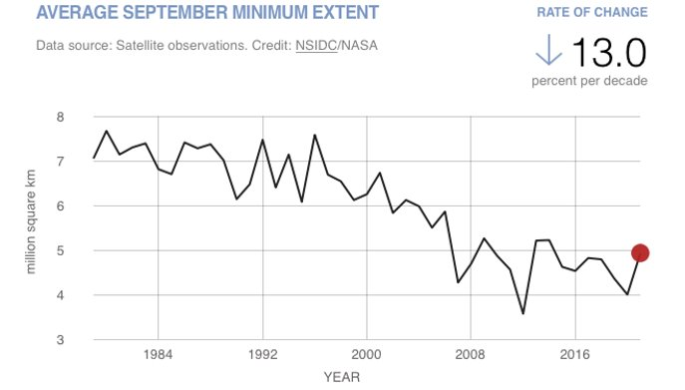
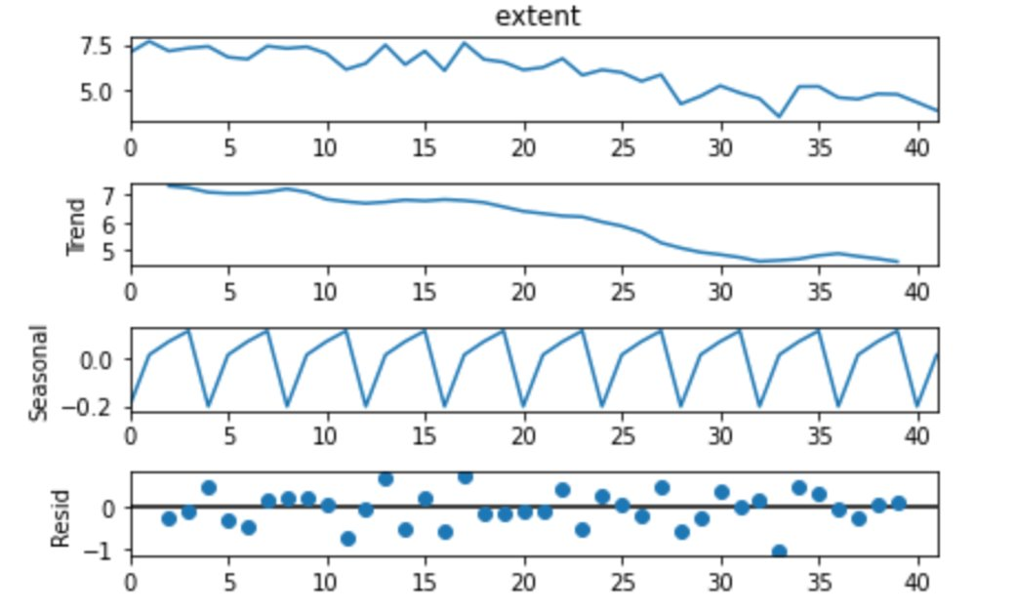
Climate Data Analysis
We can decompose the time series data into trend, seasonal and residual parts.
There is apparently a descending trend and a recurring pattern.
Data Description:
Arctic Sea Ice Minimum Extent from 1979 to 2021
Source: NASA
Notes:
https://climate.nasa.gov/vital-signs/arctic-sea-ice/

Slide 16
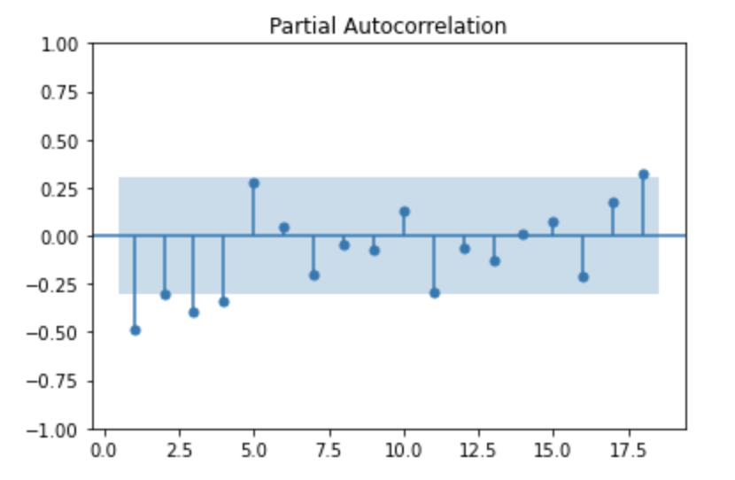
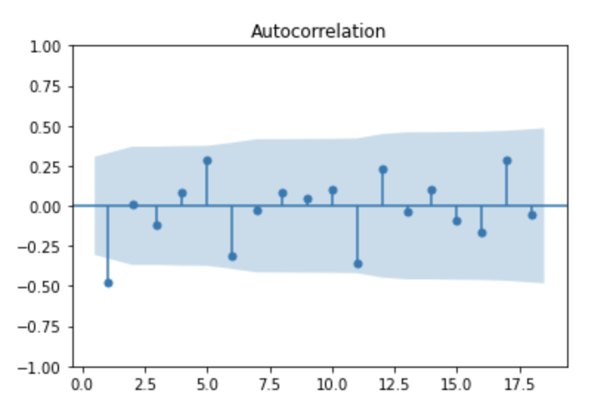
Climate Data Analysis
We use ARMA to model the data and make predictions
Step 1:
By conducting a Dickey-Fuller test, we find a stationary time series after differencing the data.
Step 2.1
The order of the Autoregressive part AR(p) is determined by the partial autocorrelation function, which is 4 in our case.
Step 2.2
The order of the Moving Average part MA(q) is determined by the autocorrelation function, which is 1 in our case.

Slide 17
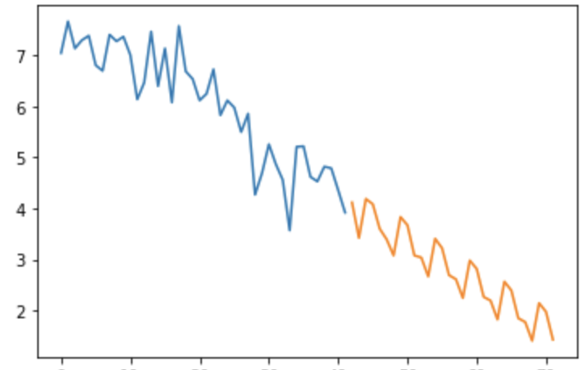
Climate Data Analysis
Result
Arctic Sea Ice Extent Prediction
According to our analysis, the minimum sea ice extent of Arctic will reduce to half of what it is now by 2050, which makes it much easier for ships to pass through the Northern Sea Route.
This will possibly result in a huge decrease in the number of ships passing from Strait of Malacca or Kra Canal. The negative effect could be reflected in the operating income.
1976
million square km
2022
2050
year

Slide 18

Financial Analysis

Slide 19

Rationale of the Financial Model
Basic Assumptions of the financial model:
Construction & Operation: Construction period: ten years from 2021-2030 / Construction cost: with a total cost of 28 Billion USD/ Operation period: 30 years from 2030-2060
Toll Charge per vessel (revenue): USD 200,000/per vessel, which is on par with the Suez and Panama Canal and could still save on fuel cost compared to the Malacca Strait option. The toll charge presumably increases at an inflation rate of 1% from 2020.
Potential number of vessels (2031-2060) through the Kra Canal = (total number of vessels sailing across Asia and Europe − number of vessels sailing through the North Sea Route) *50%
Total number of vessels sailing across Asia and Europe is predicted based on its historical data (2000-2017)
The number of vessels sailing through the North Sea Route is predicted based on its historical data(2010-2020) and the target set by President Putin(2021-2030).
Interest rate of the construction loan (Same with 20 years Thai government bond): 2.58%
Operation cost: 20% of total revenue
Corporate Tax : 20% of net income
The construction of scenario analysis depends on the melting rate of Arctic sea ice. (see next slide)

Slide 20
Financial Model
Best Case Scenario
Internal Rate Of Return: 1.6% | Total Nr. Of Vessels between Europe and Asia | Total Nr. Of Vessels transit through North Sea Route | Total Nr. Of Vessels through Malacca and Thai Canal | Predicted Nr. Of Vessels through Thai Canal | Toll Charges per vessel (USD'000) | Revnue (USD'000) | Operation Cost 20% of Revenue (USD'000) | EBIT | Debt Repayment | Construction Cost (USD'000) | Interest Rate (20 years Thai Bond) | Cumulated Cost (USD'000) | Eearning Before Tax | Thailand CorpTax (20%) | Net Profit
Y2021 |  |  |  |  | $ 200.00 |  |  |  |  | $ 2,800,000.00 | 2.58% | $ 2,872,156.00 |  |  | $ (2,872,156.00)
Y2022 |  |  |  |  | $ 202.00 |  |  |  |  | $ 2,800,000.00 | 2.58% | $ 5,818,327.00 |  |  | $ (5,818,327.00)
Y2023 |  |  |  |  | $ 204.00 |  |  |  |  | $ 2,800,000.00 | 2.58% | $ 8,840,421.00 |  |  | $ (8,840,421.00)
Y2024 |  |  |  |  | $ 206.00 |  |  |  |  | $ 2,800,000.00 | 2.58% | $ 11,940,395.00 |  |  | $ (11,940,395.00)
Y2025 |  |  |  |  | $ 208.00 |  |  |  |  | $ 2,800,000.00 | 2.58% | $ 15,120,255.00 |  |  | $ (15,120,255.00)
Y2026 |  |  |  |  | $ 210.00 |  |  |  |  | $ 2,800,000.00 | 2.58% | $ 18,382,060.00 |  |  | $ (18,382,060.00)
Y2027 |  |  |  |  | $ 212.00 |  |  |  |  | $ 2,800,000.00 | 2.58% | $ 21,727,922.00 |  |  | $ (21,727,922.00)
Y2028 |  |  |  |  | $ 214.00 |  |  |  |  | $ 2,800,000.00 | 2.58% | $ 25,160,007.00 |  |  | $ (25,160,007.00)
Y2029 |  |  |  |  | $ 216.00 |  |  |  |  | $ 2,800,000.00 | 2.58% | $ 28,680,536.00 |  |  | $ (28,680,536.00)
Y2030 |  |  |  |  | $ 218.00 |  |  |  |  | $ 2,800,000.00 | 2.58% | $ 32,291,789.00 |  |  | $ (32,291,789.00)
Y2031 | 107497 | 1,619.00 | 105,878.00 | 52,939.00 | $ 220.00 | $ 11,646,580.00 | $ 2,329,316.00 | $ 9,317,264.00 | $ 9,317,264.00 |  |  | $ 23,566,579.00 | $ - | $ - | $ (23,566,579.00)
Y2032 | 109131 | 2,015.00 | 107,116.00 | 53,558.00 | $ 222.00 | $ 11,889,876.00 | $ 2,377,975.00 | $ 9,511,901.00 | $ 9,511,901.00 |  |  | $ 14,416,867.00 | $ - | $ - | $ (14,416,867.00)
Y2033 | 110764 | 2,437.00 | 108,327.00 | 54,164.00 | $ 224.00 | $ 12,132,736.00 | $ 2,426,547.00 | $ 9,706,189.00 | $ 9,706,189.00 |  |  | $ 4,832,072.00 | $ 4,874,117.00 | $ 974,823.00 | $ 3,899,294.00
Y2034 | 112398 | 2,795.00 | 109,603.00 | 54,802.00 | $ 226.00 | $ 12,385,252.00 | $ 2,477,050.00 | $ 9,908,202.00 | $ 9,908,202.00 |  |  | $ - | $ 9,908,202.00 | $ 1,981,640.00 | $ 7,926,562.00
Y2035 | 114031 | 3,090.00 | 110,941.00 | 55,471.00 | $ 228.00 | $ 12,647,388.00 | $ 2,529,478.00 | $ 10,117,910.00 |  |  |  |  | $ 10,117,910.00 | $ 2,023,582.00 | $ 8,094,328.00
Y2036 | 115665 | 3,486.00 | 112,179.00 | 56,090.00 | $ 230.00 | $ 12,900,700.00 | $ 2,580,140.00 | $ 10,320,560.00 |  |  |  |  | $ 10,320,560.00 | $ 2,064,112.00 | $ 8,256,448.00
Y2037 | 117298 | 3,907.00 | 113,391.00 | 56,696.00 | $ 232.00 | $ 13,153,472.00 | $ 2,630,694.00 | $ 10,522,778.00 |  |  |  |  | $ 10,522,778.00 | $ 2,104,556.00 | $ 8,418,222.00
Y2038 | 118932 | 4,266.00 | 114,666.00 | 57,333.00 | $ 234.00 | $ 13,415,922.00 | $ 2,683,184.00 | $ 10,732,738.00 |  |  |  |  | $ 10,732,738.00 | $ 2,146,548.00 | $ 8,586,190.00
Y2039 | 120565 | 4,560.00 | 116,005.00 | 58,003.00 | $ 236.00 | $ 13,688,708.00 | $ 2,737,742.00 | $ 10,950,966.00 |  |  |  |  | $ 10,950,966.00 | $ 2,190,193.00 | $ 8,760,773.00
Y2040 | 122199 | 4,957.00 | 117,242.00 | 58,621.00 | $ 238.00 | $ 13,951,798.00 | $ 2,790,360.00 | $ 11,161,438.00 |  |  |  |  | $ 11,161,438.00 | $ 2,232,288.00 | $ 8,929,150.00
Y2041 | 123832 | 5,378.00 | 118,454.00 | 59,227.00 | $ 240.00 | $ 14,214,480.00 | $ 2,842,896.00 | $ 11,371,584.00 |  |  |  |  | $ 11,371,584.00 | $ 2,274,317.00 | $ 9,097,267.00
Y2042 | 125466 | 5,737.00 | 119,729.00 | 59,865.00 | $ 242.00 | $ 14,487,330.00 | $ 2,897,466.00 | $ 11,589,864.00 |  |  |  |  | $ 11,589,864.00 | $ 2,317,973.00 | $ 9,271,891.00
Y2043 | 127099 | 6,031.00 | 121,068.00 | 60,534.00 | $ 244.00 | $ 14,770,296.00 | $ 2,954,059.00 | $ 11,816,237.00 |  |  |  |  | $ 11,816,237.00 | $ 2,363,247.00 | $ 9,452,990.00
Y2044 | 128733 | 6,427.00 | 122,306.00 | 61,153.00 | $ 246.00 | $ 15,043,638.00 | $ 3,008,728.00 | $ 12,034,910.00 |  |  |  |  | $ 12,034,910.00 | $ 2,406,982.00 | $ 9,627,928.00
Y2045 | 130366 | 6,849.00 | 123,517.00 | 61,759.00 | $ 248.00 | $ 15,316,232.00 | $ 3,063,246.00 | $ 12,252,986.00 |  |  |  |  | $ 12,252,986.00 | $ 2,450,597.00 | $ 9,802,389.00
Y2046 | 132000 | 7,207.00 | 124,793.00 | 62,397.00 | $ 250.00 | $ 15,599,250.00 | $ 3,119,850.00 | $ 12,479,400.00 |  |  |  |  | $ 12,479,400.00 | $ 2,495,880.00 | $ 9,983,520.00
Y2047 | 133633 | 7,502.00 | 126,131.00 | 63,066.00 | $ 253.00 | $ 15,955,698.00 | $ 3,191,140.00 | $ 12,764,558.00 |  |  |  |  | $ 12,764,558.00 | $ 2,552,912.00 | $ 10,211,646.00
Y2048 | 135267 | 7,898.00 | 127,369.00 | 63,685.00 | $ 256.00 | $ 16,303,360.00 | $ 3,260,672.00 | $ 13,042,688.00 |  |  |  |  | $ 13,042,688.00 | $ 2,608,538.00 | $ 10,434,150.00
Y2049 | 136900 | 8,319.00 | 128,581.00 | 64,291.00 | $ 259.00 | $ 16,651,369.00 | $ 3,330,274.00 | $ 13,321,095.00 |  |  |  |  | $ 13,321,095.00 | $ 2,664,219.00 | $ 10,656,876.00
Y2050 | 138534 | 8,678.00 | 129,856.00 | 64,928.00 | $ 262.00 | $ 17,011,136.00 | $ 3,402,227.00 | $ 13,608,909.00 |  |  |  |  | $ 13,608,909.00 | $ 2,721,782.00 | $ 10,887,127.00
Y2051 | 140167 | 8,972.00 | 131,195.00 | 65,598.00 | $ 265.00 | $ 17,383,470.00 | $ 3,476,694.00 | $ 13,906,776.00 |  |  |  |  | $ 13,906,776.00 | $ 2,781,355.00 | $ 11,125,421.00
Y2052 | 141801 | 9,368.00 | 132,433.00 | 66,217.00 | $ 268.00 | $ 17,746,156.00 | $ 3,549,231.00 | $ 14,196,925.00 |  |  |  |  | $ 14,196,925.00 | $ 2,839,385.00 | $ 11,357,540.00
Y2053 | 143434 | 9,790.00 | 133,644.00 | 66,822.00 | $ 271.00 | $ 18,108,762.00 | $ 3,621,752.00 | $ 14,487,010.00 |  |  |  |  | $ 14,487,010.00 | $ 2,897,402.00 | $ 11,589,608.00
Y2054 | 145068 | 10,149.00 | 134,919.00 | 67,460.00 | $ 274.00 | $ 18,484,040.00 | $ 3,696,808.00 | $ 14,787,232.00 |  |  |  |  | $ 14,787,232.00 | $ 2,957,446.00 | $ 11,829,786.00
Y2055 | 146701 | 10,443.00 | 136,258.00 | 68,129.00 | $ 277.00 | $ 18,871,733.00 | $ 3,774,347.00 | $ 15,097,386.00 |  |  |  |  | $ 15,097,386.00 | $ 3,019,477.00 | $ 12,077,909.00
Y2056 | 148335 | 10,839.00 | 137,496.00 | 68,748.00 | $ 280.00 | $ 19,249,440.00 | $ 3,849,888.00 | $ 15,399,552.00 |  |  |  |  | $ 15,399,552.00 | $ 3,079,910.00 | $ 12,319,642.00
Y2057 | 149968 | 11,261.00 | 138,707.00 | 69,354.00 | $ 283.00 | $ 19,627,182.00 | $ 3,925,436.00 | $ 15,701,746.00 |  |  |  |  | $ 15,701,746.00 | $ 3,140,349.00 | $ 12,561,397.00
Y2058 | 151602 | 11,619.00 | 139,983.00 | 69,992.00 | $ 286.00 | $ 20,017,712.00 | $ 4,003,542.00 | $ 16,014,170.00 |  |  |  |  | $ 16,014,170.00 | $ 3,202,834.00 | $ 12,811,336.00
Y2059 | 153236 | 11,913.00 | 141,323.00 | 70,662.00 | $ 289.00 | $ 20,421,318.00 | $ 4,084,264.00 | $ 16,337,054.00 |  |  |  |  | $ 16,337,054.00 | $ 3,267,411.00 | $ 13,069,643.00
Y2060 | 154869 | 12,310.00 | 142,559.00 | 71,280.00 | $ 292.00 | $ 20,813,760.00 | $ 4,162,752.00 | $ 16,651,008.00 |  |  |  |  | $ 16,651,008.00 | $ 3,330,202.00 | $ 13,320,806.00
Suppose our prediction, that the ice will melt nearly 50% by 2050, will not happen so fast, the number of ships passing through the North Sea Route increases steadily. Under this scenario, the IRR is 1.6%, which is considered low.

Slide 21
Financial Model
Normal Prediction
Internal Rate Of Return: 1.0% | Total Nr. Of Vessels between Europe and Asia | Total Nr. Of Vessels transit through North Sea Route | Total Nr. Of Vessels through Malacca and Thai Canal | Predicted Nr. Of Vessels through Thai Canal | Toll Charges per vessel (USD'000) | Revnue (USD'000) | Operation Cost 20% of Revenue (USD'000) | EBIT | Debt Repayment | Construction Cost (USD'000) | Interest Rate (20 years Thai Bond) | Cumulated Cost (USD'000) | Eearning Before Tax | Thailand CorpTax (20%) | Net Profit
Y2021 |  |  |  |  | $ 200.00 |  |  |  |  | $ 2,800,000.00 | 2.58% | $ 2,872,156.00 |  |  | $ (2,872,156.00)
Y2022 |  |  |  |  | $ 202.00 |  |  |  |  | $ 2,800,000.00 | 2.58% | $ 5,818,327.00 |  |  | $ (5,818,327.00)
Y2023 |  |  |  |  | $ 204.00 |  |  |  |  | $ 2,800,000.00 | 2.58% | $ 8,840,421.00 |  |  | $ (8,840,421.00)
Y2024 |  |  |  |  | $ 206.00 |  |  |  |  | $ 2,800,000.00 | 2.58% | $ 11,940,395.00 |  |  | $ (11,940,395.00)
Y2025 |  |  |  |  | $ 208.00 |  |  |  |  | $ 2,800,000.00 | 2.58% | $ 15,120,255.00 |  |  | $ (15,120,255.00)
Y2026 |  |  |  |  | $ 210.00 |  |  |  |  | $ 2,800,000.00 | 2.58% | $ 18,382,060.00 |  |  | $ (18,382,060.00)
Y2027 |  |  |  |  | $ 212.00 |  |  |  |  | $ 2,800,000.00 | 2.58% | $ 21,727,922.00 |  |  | $ (21,727,922.00)
Y2028 |  |  |  |  | $ 214.00 |  |  |  |  | $ 2,800,000.00 | 2.58% | $ 25,160,007.00 |  |  | $ (25,160,007.00)
Y2029 |  |  |  |  | $ 216.00 |  |  |  |  | $ 2,800,000.00 | 2.58% | $ 28,680,536.00 |  |  | $ (28,680,536.00)
Y2030 |  |  |  |  | $ 218.00 |  |  |  |  | $ 2,800,000.00 | 2.58% | $ 32,291,789.00 |  |  | $ (32,291,789.00)
Y2031 | 107497 | 1,619.00 | 105,878.00 | 52,939.00 | $ 220.00 | $ 11,646,580.00 | $ 2,329,316.00 | $ 9,317,264.00 | $ 9,317,264.00 |  |  | $ 23,566,579.00 | $ - | $ - | $ (23,566,579.00)
Y2032 | 109131 | 2,015.00 | 107,116.00 | 53,558.00 | $ 222.00 | $ 11,889,876.00 | $ 2,377,975.00 | $ 9,511,901.00 | $ 9,511,901.00 |  |  | $ 14,416,867.00 | $ - | $ - | $ (14,416,867.00)
Y2033 | 110764 | 2,437.00 | 108,327.00 | 54,164.00 | $ 224.00 | $ 12,132,736.00 | $ 2,426,547.00 | $ 9,706,189.00 | $ 9,706,189.00 |  |  | $ 4,832,072.00 | $ 4,874,117.00 | $ 974,823.00 | $ 3,899,294.00
Y2034 | 112398 | 2,795.00 | 109,603.00 | 54,802.00 | $ 226.00 | $ 12,385,252.00 | $ 2,477,050.00 | $ 9,908,202.00 | $ 9,908,202.00 |  |  | $ - | $ 9,908,202.00 | $ 1,981,640.00 | $ 7,926,562.00
Y2035 | 114031 | 3,090.00 | 110,941.00 | 55,471.00 | $ 228.00 | $ 12,647,388.00 | $ 2,529,478.00 | $ 10,117,910.00 |  |  |  |  | $ 10,117,910.00 | $ 2,023,582.00 | $ 8,094,328.00
Y2036 | 115665 | 3,486.00 | 112,179.00 | 56,090.00 | $ 230.00 | $ 12,900,700.00 | $ 2,580,140.00 | $ 10,320,560.00 |  |  |  |  | $ 10,320,560.00 | $ 2,064,112.00 | $ 8,256,448.00
Y2037 | 117298 | 3,907.00 | 113,391.00 | 56,696.00 | $ 232.00 | $ 13,153,472.00 | $ 2,630,694.00 | $ 10,522,778.00 |  |  |  |  | $ 10,522,778.00 | $ 2,104,556.00 | $ 8,418,222.00
Y2038 | 118932 | 4,266.00 | 114,666.00 | 57,333.00 | $ 234.00 | $ 13,415,922.00 | $ 2,683,184.00 | $ 10,732,738.00 |  |  |  |  | $ 10,732,738.00 | $ 2,146,548.00 | $ 8,586,190.00
Y2039 | 120565 | 4,560.00 | 116,005.00 | 58,003.00 | $ 236.00 | $ 13,688,708.00 | $ 2,737,742.00 | $ 10,950,966.00 |  |  |  |  | $ 10,950,966.00 | $ 2,190,193.00 | $ 8,760,773.00
Y2040 | 122199 | 4,957.00 | 117,242.00 | 58,621.00 | $ 238.00 | $ 13,951,798.00 | $ 2,790,360.00 | $ 11,161,438.00 |  |  |  |  | $ 11,161,438.00 | $ 2,232,288.00 | $ 8,929,150.00
Y2041 | 123832 | 5,378.00 | 118,454.00 | 59,227.00 | $ 240.00 | $ 14,214,480.00 | $ 2,842,896.00 | $ 11,371,584.00 |  |  |  |  | $ 11,371,584.00 | $ 2,274,317.00 | $ 9,097,267.00
Y2042 | 125466 | 5,737.00 | 119,729.00 | 59,865.00 | $ 242.00 | $ 14,487,330.00 | $ 2,897,466.00 | $ 11,589,864.00 |  |  |  |  | $ 11,589,864.00 | $ 2,317,973.00 | $ 9,271,891.00
Y2043 | 127099 | 6,031.00 | 121,068.00 | 60,534.00 | $ 244.00 | $ 14,770,296.00 | $ 2,954,059.00 | $ 11,816,237.00 |  |  |  |  | $ 11,816,237.00 | $ 2,363,247.00 | $ 9,452,990.00
Y2044 | 128733 | 6,427.00 | 122,306.00 | 61,153.00 | $ 246.00 | $ 15,043,638.00 | $ 3,008,728.00 | $ 12,034,910.00 |  |  |  |  | $ 12,034,910.00 | $ 2,406,982.00 | $ 9,627,928.00
Y2045 | 130366 | 6,849.00 | 123,517.00 | 61,759.00 | $ 248.00 | $ 15,316,232.00 | $ 3,063,246.00 | $ 12,252,986.00 |  |  |  |  | $ 12,252,986.00 | $ 2,450,597.00 | $ 9,802,389.00
Y2046 | 132000 | 7,207.00 | 124,793.00 | 62,397.00 | $ 250.00 | $ 15,599,250.00 | $ 3,119,850.00 | $ 12,479,400.00 |  |  |  |  | $ 12,479,400.00 | $ 2,495,880.00 | $ 9,983,520.00
Y2047 | 133633 | 7,502.00 | 126,131.00 | 63,066.00 | $ 253.00 | $ 15,955,698.00 | $ 3,191,140.00 | $ 12,764,558.00 |  |  |  |  | $ 12,764,558.00 | $ 2,552,912.00 | $ 10,211,646.00
Y2048 | 135267 | 7,898.00 | 127,369.00 | 63,685.00 | $ 256.00 | $ 16,303,360.00 | $ 3,260,672.00 | $ 13,042,688.00 |  |  |  |  | $ 13,042,688.00 | $ 2,608,538.00 | $ 10,434,150.00
Y2049 | 136900 | 8,319.00 | 128,581.00 | 64,291.00 | $ 259.00 | $ 16,651,369.00 | $ 3,330,274.00 | $ 13,321,095.00 |  |  |  |  | $ 13,321,095.00 | $ 2,664,219.00 | $ 10,656,876.00
Y2050 | 138534 | 41,560.00 | 96,974.00 | 48,487.00 | $ 262.00 | $ 12,703,594.00 | $ 2,540,719.00 | $ 10,162,875.00 |  |  |  |  | $ 10,162,875.00 | $ 2,032,575.00 | $ 8,130,300.00
Y2051 | 140167 | 42,050.00 | 98,117.00 | 49,059.00 | $ 265.00 | $ 13,000,635.00 | $ 2,600,127.00 | $ 10,400,508.00 |  |  |  |  | $ 10,400,508.00 | $ 2,080,102.00 | $ 8,320,406.00
Y2052 | 141801 | 42,540.00 | 99,261.00 | 49,631.00 | $ 268.00 | $ 13,301,108.00 | $ 2,660,222.00 | $ 10,640,886.00 |  |  |  |  | $ 10,640,886.00 | $ 2,128,177.00 | $ 8,512,709.00
Y2053 | 143434 | 43,030.00 | 100,404.00 | 50,202.00 | $ 271.00 | $ 13,604,742.00 | $ 2,720,948.00 | $ 10,883,794.00 |  |  |  |  | $ 10,883,794.00 | $ 2,176,759.00 | $ 8,707,035.00
Y2054 | 145068 | 43,520.00 | 101,548.00 | 50,774.00 | $ 274.00 | $ 13,912,076.00 | $ 2,782,415.00 | $ 11,129,661.00 |  |  |  |  | $ 11,129,661.00 | $ 2,225,932.00 | $ 8,903,729.00
Y2055 | 146701 | 44,010.00 | 102,691.00 | 51,346.00 | $ 277.00 | $ 14,222,842.00 | $ 2,844,568.00 | $ 11,378,274.00 |  |  |  |  | $ 11,378,274.00 | $ 2,275,655.00 | $ 9,102,619.00
Y2056 | 148335 | 44,501.00 | 103,834.00 | 51,917.00 | $ 280.00 | $ 14,536,760.00 | $ 2,907,352.00 | $ 11,629,408.00 |  |  |  |  | $ 11,629,408.00 | $ 2,325,882.00 | $ 9,303,526.00
Y2057 | 149968 | 44,990.00 | 104,978.00 | 52,489.00 | $ 283.00 | $ 14,854,387.00 | $ 2,970,877.00 | $ 11,883,510.00 |  |  |  |  | $ 11,883,510.00 | $ 2,376,702.00 | $ 9,506,808.00
Y2058 | 151602 | 45,481.00 | 106,121.00 | 53,061.00 | $ 286.00 | $ 15,175,446.00 | $ 3,035,089.00 | $ 12,140,357.00 |  |  |  |  | $ 12,140,357.00 | $ 2,428,071.00 | $ 9,712,286.00
Y2059 | 153236 | 45,971.00 | 107,265.00 | 53,633.00 | $ 289.00 | $ 15,499,937.00 | $ 3,099,987.00 | $ 12,399,950.00 |  |  |  |  | $ 12,399,950.00 | $ 2,479,990.00 | $ 9,919,960.00
Y2060 | 154869 | 46,461.00 | 108,408.00 | 54,204.00 | $ 292.00 | $ 15,827,568.00 | $ 3,165,514.00 | $ 12,662,054.00 |  |  |  |  | $ 12,662,054.00 | $ 2,532,411.00 | $ 10,129,643.00
Considering our prediction that the ice will melt nearly 50% by 2050, and the North Sea Route will be passable during summertime, by 2050 30% of total vessels between Europe and Asia will choose their voyages via the North Sea Route. As a result, the remaining vessels that pass the Thai Canal will decrease in amount. Under this scenario, the IRR is 1% which is considered very low.

Slide 22
Financial Model
Worst Case Scenario
Internal Rate Of Return: 0.0% | Total Nr. Of Vessels between Europe and Asia | Total Nr. Of Vessels transit through North Sea Route | Total Nr. Of Vessels through Malacca and Thai Canal | Predicted Nr. Of Vessels through Thai Canal | Toll Charges per vessel (USD'000) | Revnue (USD'000) | Operation Cost 20% of Revenue (USD'000) | EBIT | Debt Repayment | Construction Cost (USD'000) | Interest Rate (20 years Thai Bond) | Cumulated Cost (USD'000) | Eearning Before Tax | Thailand CorpTax (20%) | Net Profit
Y2021 |  |  |  |  | $ 200.00 |  |  |  |  | $ 2,800,000.00 | 2.58% | $ 2,872,156.00 |  |  | $ (2,872,156.00)
Y2022 |  |  |  |  | $ 202.00 |  |  |  |  | $ 2,800,000.00 | 2.58% | $ 5,818,327.00 |  |  | $ (5,818,327.00)
Y2023 |  |  |  |  | $ 204.00 |  |  |  |  | $ 2,800,000.00 | 2.58% | $ 8,840,421.00 |  |  | $ (8,840,421.00)
Y2024 |  |  |  |  | $ 206.00 |  |  |  |  | $ 2,800,000.00 | 2.58% | $ 11,940,395.00 |  |  | $ (11,940,395.00)
Y2025 |  |  |  |  | $ 208.00 |  |  |  |  | $ 2,800,000.00 | 2.58% | $ 15,120,255.00 |  |  | $ (15,120,255.00)
Y2026 |  |  |  |  | $ 210.00 |  |  |  |  | $ 2,800,000.00 | 2.58% | $ 18,382,060.00 |  |  | $ (18,382,060.00)
Y2027 |  |  |  |  | $ 212.00 |  |  |  |  | $ 2,800,000.00 | 2.58% | $ 21,727,922.00 |  |  | $ (21,727,922.00)
Y2028 |  |  |  |  | $ 214.00 |  |  |  |  | $ 2,800,000.00 | 2.58% | $ 25,160,007.00 |  |  | $ (25,160,007.00)
Y2029 |  |  |  |  | $ 216.00 |  |  |  |  | $ 2,800,000.00 | 2.58% | $ 28,680,536.00 |  |  | $ (28,680,536.00)
Y2030 |  |  |  |  | $ 218.00 |  |  |  |  | $ 2,800,000.00 | 2.58% | $ 32,291,789.00 |  |  | $ (32,291,789.00)
Y2031 | 107497 | 1,619.00 | 105,878.00 | 52,939.00 | $ 220.00 | $ 11,646,580.00 | $ 2,329,316.00 | $ 9,317,264.00 | $ 9,317,264.00 |  |  | $ 23,566,579.00 | $ - | $ - | $ (23,566,579.00)
Y2032 | 109131 | 2,015.00 | 107,116.00 | 53,558.00 | $ 222.00 | $ 11,889,876.00 | $ 2,377,975.00 | $ 9,511,901.00 | $ 9,511,901.00 |  |  | $ 14,416,867.00 | $ - | $ - | $ (14,416,867.00)
Y2033 | 110764 | 2,437.00 | 108,327.00 | 54,164.00 | $ 224.00 | $ 12,132,736.00 | $ 2,426,547.00 | $ 9,706,189.00 | $ 9,706,189.00 |  |  | $ 4,832,072.00 | $ 4,874,117.00 | $ 974,823.00 | $ 3,899,294.00
Y2034 | 112398 | 2,795.00 | 109,603.00 | 54,802.00 | $ 226.00 | $ 12,385,252.00 | $ 2,477,050.00 | $ 9,908,202.00 | $ 9,908,202.00 |  |  | $ - | $ 9,908,202.00 | $ 1,981,640.00 | $ 7,926,562.00
Y2035 | 114031 | 3,090.00 | 110,941.00 | 55,471.00 | $ 228.00 | $ 12,647,388.00 | $ 2,529,478.00 | $ 10,117,910.00 |  |  |  |  | $ 10,117,910.00 | $ 2,023,582.00 | $ 8,094,328.00
Y2036 | 115665 | 3,486.00 | 112,179.00 | 56,090.00 | $ 230.00 | $ 12,900,700.00 | $ 2,580,140.00 | $ 10,320,560.00 |  |  |  |  | $ 10,320,560.00 | $ 2,064,112.00 | $ 8,256,448.00
Y2037 | 117298 | 3,907.00 | 113,391.00 | 56,696.00 | $ 232.00 | $ 13,153,472.00 | $ 2,630,694.00 | $ 10,522,778.00 |  |  |  |  | $ 10,522,778.00 | $ 2,104,556.00 | $ 8,418,222.00
Y2038 | 118932 | 4,266.00 | 114,666.00 | 57,333.00 | $ 234.00 | $ 13,415,922.00 | $ 2,683,184.00 | $ 10,732,738.00 |  |  |  |  | $ 10,732,738.00 | $ 2,146,548.00 | $ 8,586,190.00
Y2039 | 120565 | 4,560.00 | 116,005.00 | 58,003.00 | $ 236.00 | $ 13,688,708.00 | $ 2,737,742.00 | $ 10,950,966.00 |  |  |  |  | $ 10,950,966.00 | $ 2,190,193.00 | $ 8,760,773.00
Y2040 | 122199 | 24,440.00 | 97,759.00 | 48,880.00 | $ 238.00 | $ 11,633,440.00 | $ 2,326,688.00 | $ 9,306,752.00 |  |  |  |  | $ 9,306,752.00 | $ 1,861,350.00 | $ 7,445,402.00
Y2041 | 123832 | 24,766.00 | 99,066.00 | 49,533.00 | $ 240.00 | $ 11,887,920.00 | $ 2,377,584.00 | $ 9,510,336.00 |  |  |  |  | $ 9,510,336.00 | $ 1,902,067.00 | $ 7,608,269.00
Y2042 | 125466 | 25,093.00 | 100,373.00 | 50,187.00 | $ 242.00 | $ 12,145,254.00 | $ 2,429,051.00 | $ 9,716,203.00 |  |  |  |  | $ 9,716,203.00 | $ 1,943,241.00 | $ 7,772,962.00
Y2043 | 127099 | 25,420.00 | 101,679.00 | 50,840.00 | $ 244.00 | $ 12,404,960.00 | $ 2,480,992.00 | $ 9,923,968.00 |  |  |  |  | $ 9,923,968.00 | $ 1,984,794.00 | $ 7,939,174.00
Y2044 | 128733 | 25,747.00 | 102,986.00 | 51,493.00 | $ 246.00 | $ 12,667,278.00 | $ 2,533,456.00 | $ 10,133,822.00 |  |  |  |  | $ 10,133,822.00 | $ 2,026,764.00 | $ 8,107,058.00
Y2045 | 130366 | 26,073.00 | 104,293.00 | 52,147.00 | $ 248.00 | $ 12,932,456.00 | $ 2,586,491.00 | $ 10,345,965.00 |  |  |  |  | $ 10,345,965.00 | $ 2,069,193.00 | $ 8,276,772.00
Y2046 | 132000 | 26,400.00 | 105,600.00 | 52,800.00 | $ 250.00 | $ 13,200,000.00 | $ 2,640,000.00 | $ 10,560,000.00 |  |  |  |  | $ 10,560,000.00 | $ 2,112,000.00 | $ 8,448,000.00
Y2047 | 133633 | 26,727.00 | 106,906.00 | 53,453.00 | $ 253.00 | $ 13,523,609.00 | $ 2,704,722.00 | $ 10,818,887.00 |  |  |  |  | $ 10,818,887.00 | $ 2,163,777.00 | $ 8,655,110.00
Y2048 | 135267 | 27,053.00 | 108,214.00 | 54,107.00 | $ 256.00 | $ 13,851,392.00 | $ 2,770,278.00 | $ 11,081,114.00 |  |  |  |  | $ 11,081,114.00 | $ 2,216,223.00 | $ 8,864,891.00
Y2049 | 136900 | 27,380.00 | 109,520.00 | 54,760.00 | $ 259.00 | $ 14,182,840.00 | $ 2,836,568.00 | $ 11,346,272.00 |  |  |  |  | $ 11,346,272.00 | $ 2,269,254.00 | $ 9,077,018.00
Y2050 | 138534 | 69,267.00 | 69,267.00 | 34,634.00 | $ 262.00 | $ 9,074,108.00 | $ 1,814,822.00 | $ 7,259,286.00 |  |  |  |  | $ 7,259,286.00 | $ 1,451,857.00 | $ 5,807,429.00
Y2051 | 140167 | 70,084.00 | 70,083.00 | 35,042.00 | $ 265.00 | $ 9,286,130.00 | $ 1,857,226.00 | $ 7,428,904.00 |  |  |  |  | $ 7,428,904.00 | $ 1,485,781.00 | $ 5,943,123.00
Y2052 | 141801 | 70,901.00 | 70,900.00 | 35,450.00 | $ 268.00 | $ 9,500,600.00 | $ 1,900,120.00 | $ 7,600,480.00 |  |  |  |  | $ 7,600,480.00 | $ 1,520,096.00 | $ 6,080,384.00
Y2053 | 143434 | 71,717.00 | 71,717.00 | 35,859.00 | $ 271.00 | $ 9,717,789.00 | $ 1,943,558.00 | $ 7,774,231.00 |  |  |  |  | $ 7,774,231.00 | $ 1,554,846.00 | $ 6,219,385.00
Y2054 | 145068 | 72,534.00 | 72,534.00 | 36,267.00 | $ 274.00 | $ 9,937,158.00 | $ 1,987,432.00 | $ 7,949,726.00 |  |  |  |  | $ 7,949,726.00 | $ 1,589,945.00 | $ 6,359,781.00
Y2055 | 146701 | 73,351.00 | 73,350.00 | 36,675.00 | $ 277.00 | $ 10,158,975.00 | $ 2,031,795.00 | $ 8,127,180.00 |  |  |  |  | $ 8,127,180.00 | $ 1,625,436.00 | $ 6,501,744.00
Y2056 | 148335 | 74,168.00 | 74,167.00 | 37,084.00 | $ 280.00 | $ 10,383,520.00 | $ 2,076,704.00 | $ 8,306,816.00 |  |  |  |  | $ 8,306,816.00 | $ 1,661,363.00 | $ 6,645,453.00
Y2057 | 149968 | 74,984.00 | 74,984.00 | 37,492.00 | $ 283.00 | $ 10,610,236.00 | $ 2,122,047.00 | $ 8,488,189.00 |  |  |  |  | $ 8,488,189.00 | $ 1,697,638.00 | $ 6,790,551.00
Y2058 | 151602 | 75,801.00 | 75,801.00 | 37,901.00 | $ 286.00 | $ 10,839,686.00 | $ 2,167,937.00 | $ 8,671,749.00 |  |  |  |  | $ 8,671,749.00 | $ 1,734,350.00 | $ 6,937,399.00
Y2059 | 153236 | 76,618.00 | 76,618.00 | 38,309.00 | $ 289.00 | $ 11,071,301.00 | $ 2,214,260.00 | $ 8,857,041.00 |  |  |  |  | $ 8,857,041.00 | $ 1,771,408.00 | $ 7,085,633.00
Y2060 | 154869 | 77,435.00 | 77,434.00 | 38,717.00 | $ 292.00 | $ 11,305,364.00 | $ 2,261,073.00 | $ 9,044,291.00 |  |  |  |  | $ 9,044,291.00 | $ 1,808,858.00 | $ 7,235,433.00
Suppose the Arctic ice will melt 50% by 2050 by our prediction, the Northern Sea Route will be passable throughout the year. Under this scenario, by 2040, 20% of total vessels between Europe and Asia will voyage via the Northern Sea Route and the number will increase to 50% by 2050. As a result, the remaining number of vessels which pass through the Thai Canal will be significantly reduced. The IRR in this case is 0%, meaning the project is not going to profit financially.

Slide 23
Advice/
Decision

Slide 24
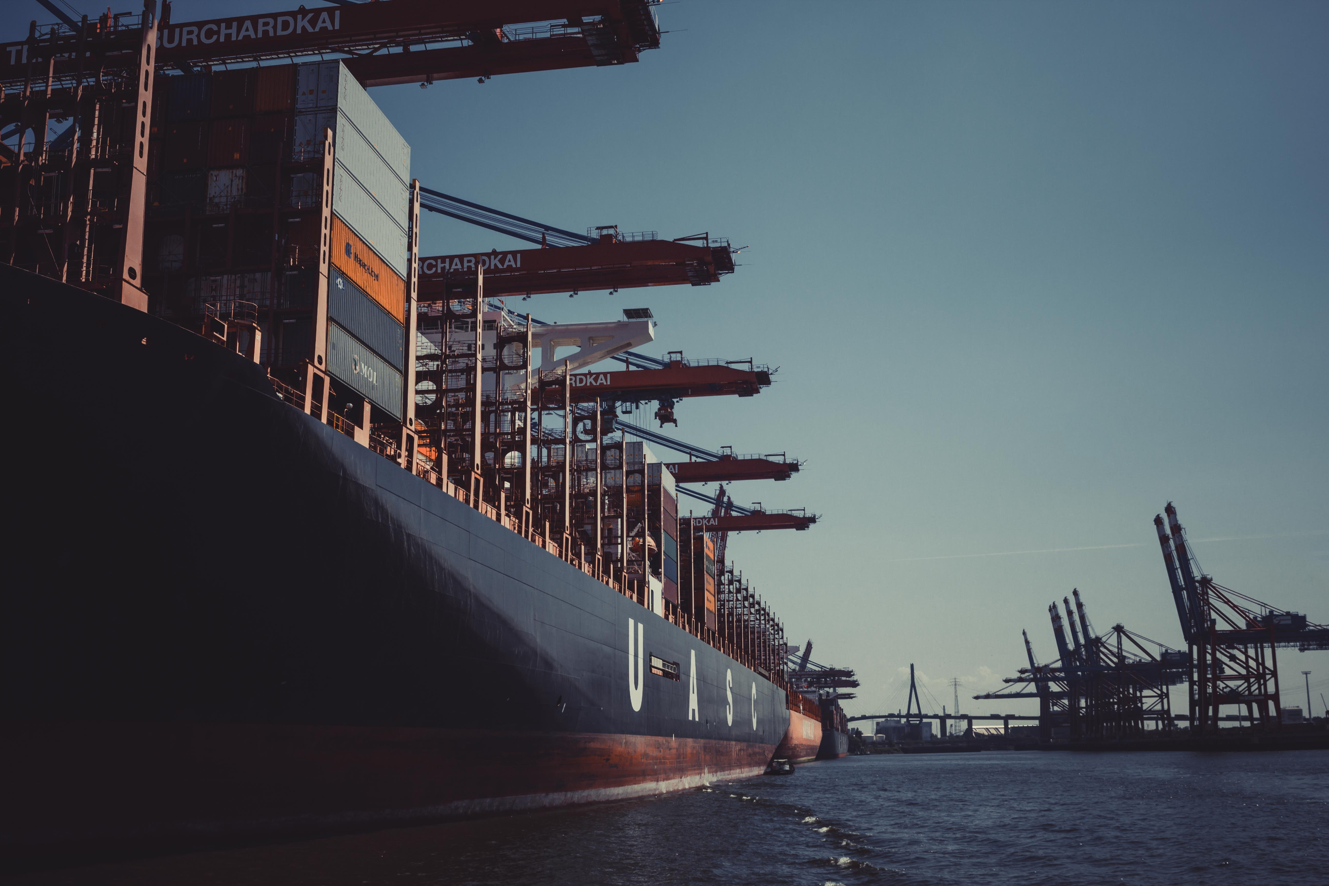
Conclusion
The Kra Canal project should NOT be implemented, based on the following reasons:
Complex geopolitical factors impede the feasibility of Kra Canal project
Kra Canal creates a physical boundary between the Thai ethnic majority and the Malay ethnic minority which could fuel the already strained racial conflicts in southern Thailand
Even though Thailand’s economy could potentially benefit from the project, there are still many risks and uncertainties to be managed
The melting of Arctic sea ice makes it possible for a much shorter and cheaper route -- Northern Sea Route
The Kra Canal project has a very low chance of profiting

Slide 25
Thanks for your attention.

